Slide 1
Security Design Principles

Slide 2
Defense-in-Depth

Slide 3
Defense-in-Depth
Defense-in-depth is a strategy to handle FAILURES
If one type of defense fails, you fall back to another
Multiple layers of security
Deterrence
Response and recovery
For example:
Input validation fails, but the attacker doesn’t have enough permissions to do anything useful.
The attacker manages to raise privileges, but there is no data on the container.
There is data, but the incident is logged and alerted.

Slide 4
Fail Safe

Slide 5
Fail Safe
Fail safe, also known as fail-secure or graceful degradation, is the principle of designing applications to fail in a predictable and secure way when an unexpected event occurs.
This strategy can help minimize damage to your system and reduce the risk of data breaches.
Graceful error handling
Logging and monitoring

Slide 6
Least Privilege

Slide 7
Least Privilege
Principle of least privilege is about granting only necessary permissions to users or processes
The idea is to minimize potential damage in case an account is compromised.
Periodic privilege reviews

Slide 8
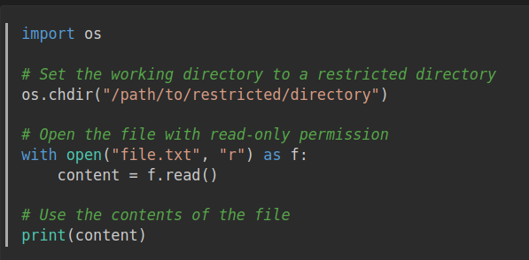
Least Privilege Example
Imagine you have a Python script that needs to read a file from the filesystem.
The script should only have the minimum necessary permissions to perform this task, i.e., it should not have permission to write or execute any other files in the system.
Here's an example of how you could implement this using Python:

Slide 9
Least Privilege and Defense in Depth
Acccording to Defense in Depth, there should be other protections in place in case someone compromises the script
For example, OS-level permissions to restrict the user running the script to read-only
This multi-layer defense ensures that even if the script is compromised, the damage is minimal.

Slide 10
Separation of Duties

Slide 11
Separation of Duties
Separation of duties is a control designed to minimize risk by breaking a task into multiple roles.
No role can perform the entire task
Therefore no role can compromise the system
Segregation of roles
Access controls
For example, a doctor gives a prescription but not the actual medicine.

Slide 12
Economy of Mechanism

Slide 13
Economy of Mechanism
Economy of mechanism is about designing systems with as few components as possible while still maintaining security, ensuring that every component has a clear purpose and function.
Simplify design
Avoid unnecessary complexity
Sometimes this principle conflicts with separation of duties and defense in depth...

Slide 14
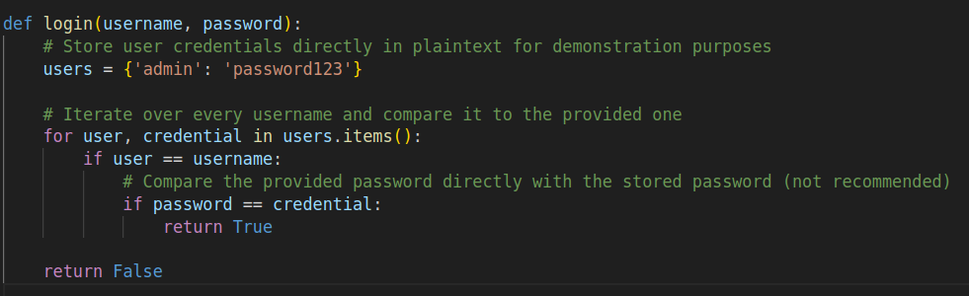
Economy of Mechanism Example
The following does unnecessary iteration and adds risk:

Slide 15
Complete Mediation

Slide 16
Complete Mediation
Complete mediation is about monitoring and controlling every action taken within a system.
It's an essential component of role-based access control (RBAC) systems, where each user has a clearly defined role and set of permissions.
Centralized access control
Monitor every interaction (realistically, authenticate every request)
Implement mandatory access control (MAC)
Conflicts with Economy of Mechanism

Slide 17
Open Design

Slide 18
Open Design
Open design is about building systems with open interfaces and accessible documentation
Encourages transparency and collaboration in the development community
This strategy can improve overall system security by fostering a culture of collective responsibility for finding and addressing vulnerabilities.
Public APIs
Security through transparency (not through obscurity)

Slide 19
Least Common Mechanism

Slide 20
Least Common Mechanism
Least common mechanism is about reducing the number of shared components or services within a system
Minimize the potential attack surface and decrease the risk of vulnerabilities being exploited across multiple systems.
Distributed architecture
Redundant processes

Slide 21
Psychological acceptability

Slide 22
Psychological acceptability
Psychological acceptability is about making your security transparent to the user
Security is not a feature (for standard apps)
Security is overhead
The user is not the attacker (presumption of innocence)
Don’t make it hard on the user, make it hard on the attacker
Don’t convert the user to an attacker

Slide 23
Weakest Link

Slide 24
Weakest Link
Your system is as secure as its weakest link
The attacker will look for the weakest links
Vendor Security / Supply Chain
Continuous improvement
User awareness
Defense in Depth

Slide 25
Leveraging Existing Components

Slide 26
Leveraging Existing Components
Leveraging existing components is a strategy that involves using pre-built libraries, frameworks, or software to speed up development without sacrificing security.
However, it's essential to thoroughly assess these components for any potential vulnerabilities.
Vendor responsibility
Continuous monitoring and patching

Slide 27
^{Trade-offs}
1. Defense-in-Depth: can introduce redundancies and complexity that may impact efficiency. Additionally, having too many layers can make it more difficult to troubleshoot issues when they arise.
2. Fail Safe: may introduce performance degradation if implemented excessively. For example, implementing a fail-safe mechanism that prevents all access to a system in case of a breach could impact efficiency by limiting user interaction with the system.
3. Least Privilege: can increase operational complexity and reduce efficiency if not implemented correctly. For instance, granting too few permissions may hinder employees' productivity, or granting too many permissions may pose a security risk.
4. Separation of Duties: can introduce additional administrative overhead and decrease efficiency due to the need for more communication and coordination
between team members.

Slide 28
^{Trade-offs}
5. Economy of Mechanism: it may be difficult to apply this principle strictly
without compromising system functionality or introducing potential vulnerabilities.
6. Complete Mediation: can introduce performance degradation due to the additional processing required for each request.
7. Open Design: may expose sensitive information and increase the risk of
cyberattacks if not properly protected. Additionally, implementing this principle can introduce delays during the development phase due to the need for multiple iterations and reviews.
8. Least Common Mechanism: may increase complexity and reduce efficiency by requiring additional resources and maintenance efforts.

Slide 29
^{Trade-offs}
9. Psychological Acceptability: may lead to the implementation of less secure but more user-friendly mechanisms.
10. Weakest Link: can lead to inadequate attention being given to other areas of the system, potentially introducing new weaknesses.

